Slide 1
PLASTIC SURGERY
Name:
Date:

Slide 2

Looks have taken over moral principles and mannerisms in the current world.
Be it in hiring process or even searching for a marriage partner.
And when looks matters in such affairs, body building, make-ups or push-up bras currently offer little solution to achieving such an appearance perfection.
A more effective and well accepted option has emerged in the past years as a result of advancement in cosmetic medicine: plastic surgery

Slide 3
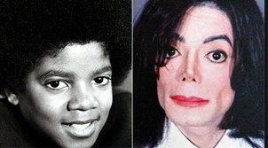
Also known as cosmetic surgery
It involves the reconstruction, repair or replacing of external organs.
It can also entail the enhancement of their appearance by applying medical and cosmetics procedures with an aim of getting a predetermined look (Singh et al 6).
Plastic surgery was brought to limelight by the late pop music star Michael Jackson due to his global fame and his desire to convert from a black to white.

Slide 4
Origin of Plastic Surgery
This trend of enhancing beauty has taken a more different twist in the recent past.
Among the ancient African communities, painting face with bright color was considered as a way embracing one’s beauty.
The Indians started the art of performing nose lifts to increase beauty.
Other communities from all over the world copied this art, making the art of face lifting and breast firming more advanced (McNab 14).
Currently, the term “plastic surgery” is more popular and more celebrities continue to adopt this art and many of their followers desire to ape their appearance enhancement technique.

Slide 5

The Maasai tribe of Kenya still uses red ochre to paint their faces as way of enhancing their beauty.

Slide 6
Plastic surgery enables patients who have suffered severe deformities such as burns to restore their outlook.
Other patients suffer from ailments that may negatively impact their skin or cause hair loss.
Such groups of patients have to undergo plastic surgery to avert the negative consequences of the diseases spreading to their skin and causing disfigured outlook.
Such cases are generally justifiable and are a main talk point of the proponents of this art. Finally, many rich people are able to afford the resources required to get several plastic surgeries (Smith & Amir 14).

Slide 7

Improved self confidence
Kim Kardashian after her facial cosmetic surgery.
The proponents of plastic surgery argue that it improves one’s appearance and self-confidence by aiding them to achieve their desired physical appearance.
A higher sense of self-confidence makes cosmetic surgery recipients more confident and is able to easily improve their social interaction.

Slide 8
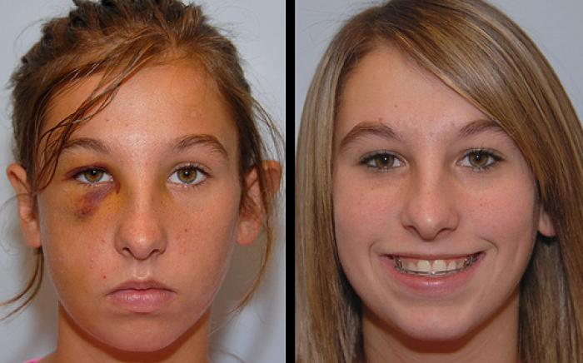
ENABLES RECONSTRUCTIVE SURGERIES
A patient after a facial reconstructive surgery.
Plastic surgery enables patients who have suffered severe deformities such as burns to restore their outlook.
Other patients suffer from ailments that may negatively impact their skin or cause hair loss.
Such groups of patients have to undergo plastic surgery to avert the negative consequences of the diseases spreading to their skin and causing disfigured outlook.
Survivors from accidents who suffer big scars in sensitive body parts such as face scars after healing their wounds may seek plastic surgery services to rectify their appearance (Archer & Roberto 18).

Slide 9
Despite the highlighted benefits, there are copious drawbacks that render plastic surgery unviable and a risky option due to their severity.
Plastic surgery is an extremely expensive medical procedure that is not affordable to most people.
Although many people may be able to pool the initial surgery costs, the required after-surgery things may be too expensive making many people unable to attain their desired outcome (Ross et al 110).
The appearance after a failed plastic surgery may devastate the recipients which further worsen their personal complexes perception.

Slide 10
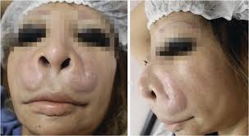
Complications and DEATHS
An example of a failed facial plastic surgery.
The increasing number of cases involving untrained surgeons conducting plastic surgery significantly increases the risk of unexpected outcome or even death of recipients.
The risk mostly faces the low-income patients who are likely to be lured by the fake surgeons who charged cheap prices to the gullible masses that are easily attracted by the mirage of beauty visions of plastic surgery on the magazines (Ross et al 122).

Slide 11

ADDICTION
Addiction to Plastic Surgery Illustration
Even after undergoing a successful plastic surgery, the urge to keep changing physical appearance can tend to be addictive.
After a recipient sees the perfection of one part of the body, they may see the need to perfect another part that they now consider as imperfect.
Interestingly, other patients may realize after sometimes that the newly acquired look are no longer attractive and thus start demand their original parts back. Such “revisions” of plastic surgery are expensive and detrimental to the recipients due to the drugs administered during the reconstruction surgeries (Friedrich 20).

Slide 12
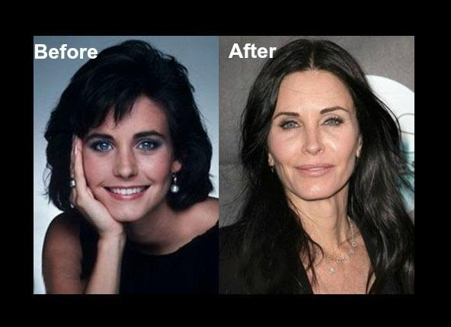
Health dangers
The dangers to health makes the art of plastic surgery can be further increased by the unintended changes in the reconstructed organs.
Moreover, the patients have to deal with the negative impacts of anesthesia which can make the patients to be immunologically weak or even sometimes fatal.
During the healing phase, patients who are unable to afford the required after-theatre care in hospital may suffer from secondary infections which can make the phase to be painful (Friedrich 18).
Plastic surgery graft failures

Slide 13
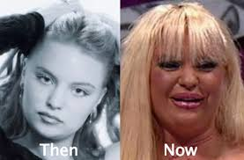
Permanent DISFUGARATION
Permanent negative changes
The risk of unpredicted results that disfigure the facial and physical appearance after a failed plastic surgery further aggravates self-esteem and self-confidence of the patients.
Although the intention of undergoing the plastic surgery was to boost the already perceived low self-esteem, there are sound probabilities of the surgery further worsening self-esteem of the recipients as it can lead to patients developing scary appearances.

Slide 14
Conclusion
Although a plastic surgery offers a temporary solution by giving a more sense of esteem confidence, the possible resultant negative consequences that can arise from its failure and considering its costly requirements clearly points to its redundancy nature.
There are numerous health risks that are attributed to graft rejection after a plastic surgery.
These adverse outcomes of plastic surgery make this outlook enhancement procedure a mere illusion of trying to be/ remain attractive.
The ideas of being youthful or being super attractive are mere illusions and are not worth the risks of plastic surgery.

Slide 15
References
Archer, Kaete A., and Roberto Eloy Garcia. "Silhouette Instalift: Benefits to a Facial Plastic Surgery Practice." Facial Plastic Surgery Clinics (2019).
Friedrich, M. J. "Dangers of Substandard or Falsified Medicines." Jama 319.3 (2018): 219-219.
McNab, Nan. Body Bizarre, Body Beautiful. Simon and Schuster, 2010.
Ross, Kimberly M., et al. "Plastic surgery complications from medical tourism treated in a US academic medical center." Plastic and reconstructive surgery 141.4 (2018): 517e-523e.
Singh, Richa, et al. "Plastic surgery: A new dimension to face recognition." IEEE Transactions on Information Forensics and Security 5.3 (2010): 441-448.
Smith, Margaret E., and Amir A. Ghaferi. "Understanding the Benefits of Bariatric Surgery: How Much Evidence Is Enough?." JAMA surgery 153.11 (2018): e183332-e183332.

